Slide 1
Installation Guide
(WAS – Jeus 5.0.0.26)
2008. 12. 30
CODELABOR
Shin Sang Jae (codelabor@gmail.com)

Slide 2
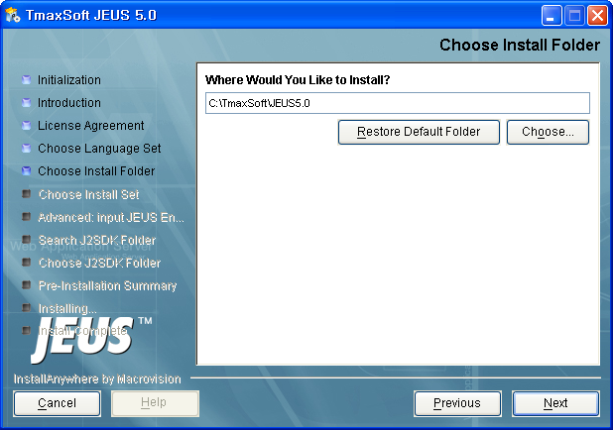

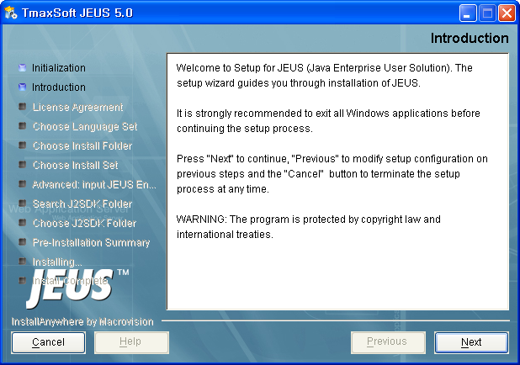
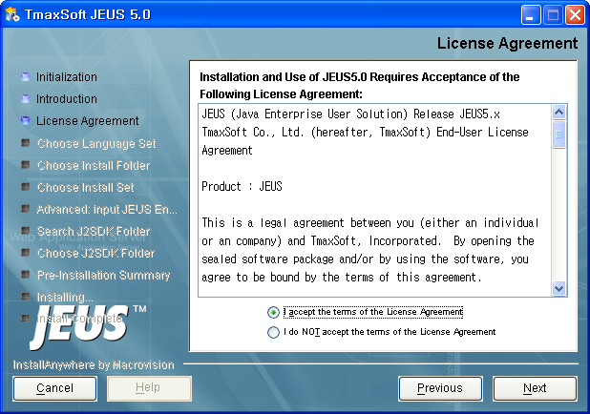
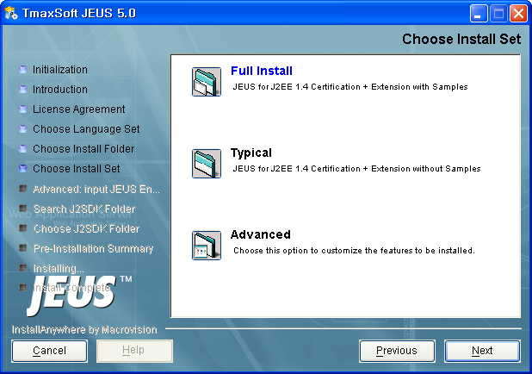
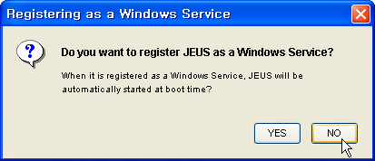
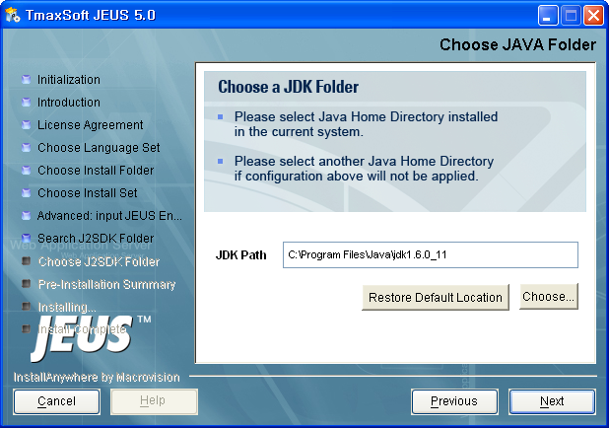
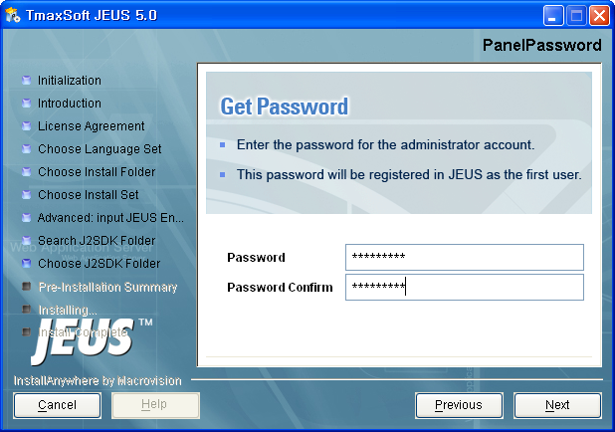
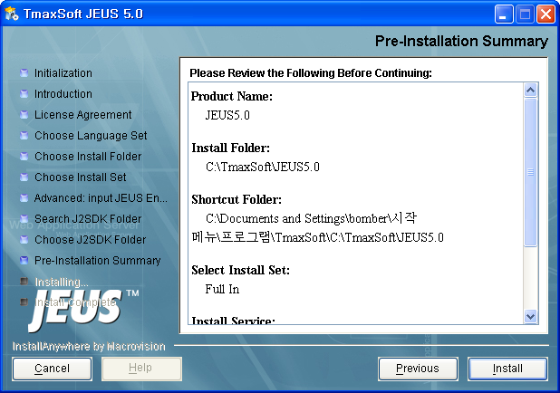
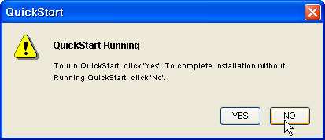
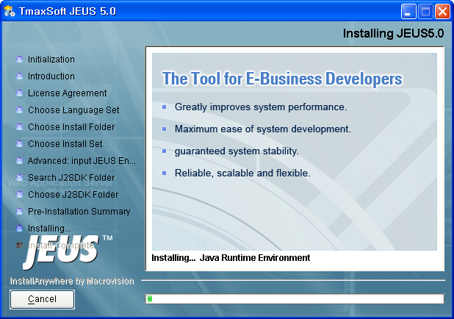
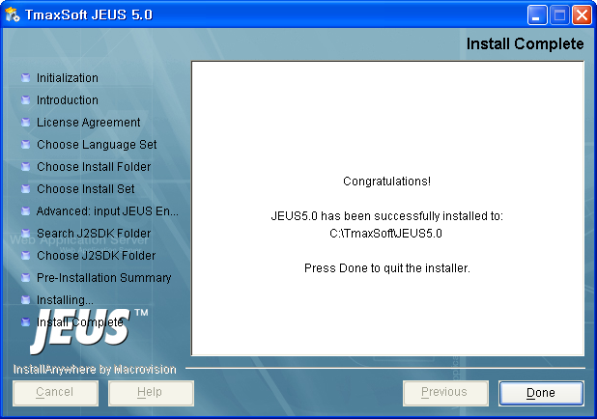
Database
Installation
File: jeus50-win-en.exe
Install directory: C:\TmaxSoft\JEUS5.0

Slide 3
Database
Installation
Install Set: Full Install
Register JEUS as a Windows Service: No
JDK Path: C:\Program Files\Java\jdk1.6.0_11
Password: jeusadmin

Slide 4
Database
Installation
QuickStart Running: No

Slide 5
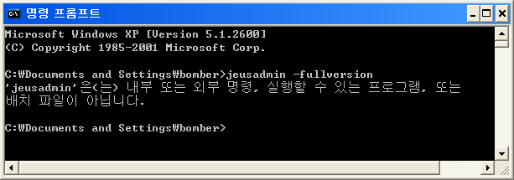
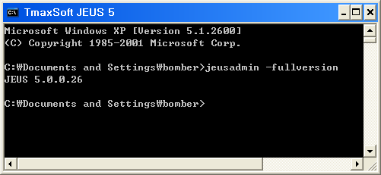
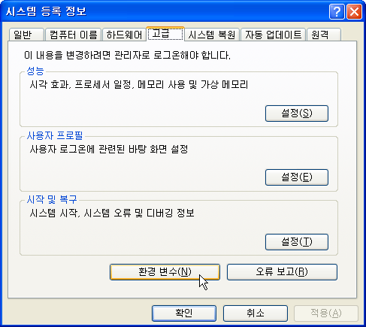
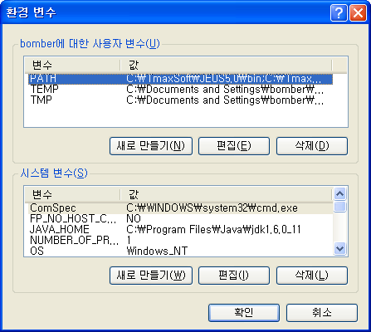
Database
Installation
Check Version: jeusadmin -fullversion

